Slide 1



GRANT FUNDING OPPORTUNITIES WEBINAR
Climate Pollution Reduction Grant Program
February 2026

Slide 2
AGENDA
Illinois Climate Bank Overview
CPRG Background
Grant Funding Opportunities Overview
Stretch Code Adoption Grants
Small Utility Clean Energy Planning Grants
Q&A
Next Steps and Resources
Other IFA Resources

Slide 3


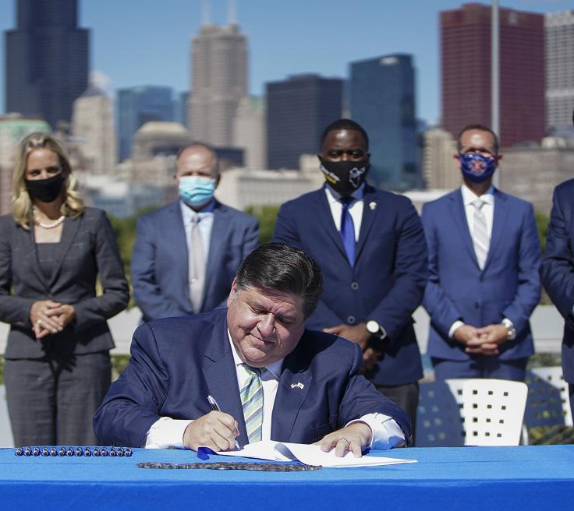
THE IFA WAS DESIGNATED AS THE CLIMATE BANK BY CEJA
CLIMATE BANK PURPOSE
(1) The distribution of the benefits of clean energy in an equitable manner;
(2) Making clean energy accessible to all; and
(3) Accelerating the investment of private capital into clean energy projects in a manner reflective of the geographic, racial, ethnic, gender, and income-level diversity of the State.
- Climate & Equitable Jobs Act, 2021 (20 ILCS 3501/850-15)

Slide 4
OVERVIEW Climate Pollution Reduction Grant
In October 2024, the US Environmental Protection Agency awarded the state of Illinois, through the Illinois EPA, $430,000,000 under the Climate Pollution Reduction Grant (CPRG) to implement several initiatives and programs across 5 key sectors. These sectors include buildings, transportation, agriculture, power, and industry.
The Illinois Climate Bank received a subaward of $137,000,000 to implement several initiatives and programs under the CPRG award that aligns with Illinois state policy and CEJA.

Slide 5
Grant Funding Opportunities Overview
The Illinois Climate Bank currently has two competitive grant solicitations open under CPRG, each aligned with Illinois’ climate and equity goals.
Grant Opportunity Name | Estimated Total Program Funding | Award Range | Application Due Date | Eligible Applicants
Stretch Code Adoption Grants | $6,698,352 | Up to $200,000 per award | April 30, 2026 | Municipalities
Small Utility Clean Energy Planning | $1,600,000 | Up to $200,000 per award | April 17, 2026 | Municipal and cooperative electric utilities

Slide 6
Stretch Code Adoption Grants: Program Purpose
The Stretch Building Code Adoption Grant Program is designed to facilitate the adoption, implementation, and enforcement of the Illinois Stretch Energy Code by municipalities. The program will provide financial support for education, community engagement, and technical assistance to ensure that municipalities are well equipped to integrate the stretch code into their regulatory frameworks. Applicants are not required to meet all program objectives.
Only a municipality defined in the Energy Efficient Building Act (20 ILCS 3125/1) as any city, village, or incorporated town is eligible to apply.
The program objectives may include:
Municipal awareness and capacity building,
Community engagement and education,
Incremental code modernization, and
Emissions reductions and energy efficiency improvements
STRECH CODE ADOPTION GRANTS

Slide 7
Stretch Code Adoption Grants: Objectives
Objective 1: Municipal Awareness and Capacity Building
Objective: Enhance the ability of municipalities to adopt and implement the Illinois Stretch Energy Code by providing funding for education, training, and internal capacity development. This will ensure that municipalities have the knowledge, resources, and administrative processes necessary to successfully integrate the stretch code.
Intended Outcomes: Municipalities will develop the internal knowledge and resources needed to adopt and implement the stretch code. These efforts are expected to lead to increased adoption of the stretch energy code.
Metric: Grant recipients will track the number of municipal staff and local council members trained on the stretch code, including the number of training sessions and workshops held.
See NOFO for more details: https://illinoisclimatebank.com/financing-programs/local-governments-nonprofits/stretch-building-code-adoption-support/
STRECH CODE ADOPTION GRANTS

Slide 8
Stretch Code Adoption Grants: Objectives
Objective 2: Community Engagement and Education
Objective: Support municipalities in conducting outreach and education efforts to inform residents, businesses, and stakeholders about the stretch code and its benefits, ultimately increasing public understanding and acceptance.
Intended Outcomes: Municipalities will conduct effective community outreach to increase awareness and acceptance of stretch code adoption. Municipalities will identify and address public questions and concerns related to stretch code adoption.
Metrics: The grant recipient will track the number and type of community engagement activities. The grant recipient may need to provide a summary of the engagement key findings and outcomes.
See NOFO for more details: https://illinoisclimatebank.com/financing-programs/local-governments-nonprofits/stretch-building-code-adoption-support/
STRECH CODE ADOPTION GRANTS

Slide 9
Stretch Code Adoption Grants: Objectives
Objective 3: Incremental Code Modernization
Objective: Based on stakeholder feedback, it became evident that many municipalities require additional support in updating base codes before they can realistically adopt stretch energy codes. The objective is to consider municipalities that present a clear and structured plan for a staged approach, including updates to base codes and a timeline for future stretch code adoption.
Intended Outcomes: Municipalities requiring preliminary updates to base codes will develop structured plans and roadmaps for stretch code adoption. Municipalities will integrate incremental code updates that align with statewide energy efficiency goals. A phased approach will ensure that municipalities can successfully implement stretch code requirements over time.
Metrics: The number of municipalities that adopt updated codes, as well as the percentage of those municipalities that subsequently proceed with the successful adoption of the stretch code.
See NOFO for more details: https://illinoisclimatebank.com/financing-programs/local-governments-nonprofits/stretch-building-code-adoption-support/
STRECH CODE ADOPTION GRANTS

Slide 10
Stretch Code Adoption Grants: Objectives
Objective 4: Emissions Reductions and Energy Efficiency Improvements
Objectives: Support the long-term reduction of greenhouse gas emissions and improvements in energy efficiency through the widespread adoption of the stretch code while ensuring municipalities commit to sustained energy efficiency goals and measurable emissions reductions that align with the overall state goals set by CEJA.
Intended Outcomes: The adoption of the stretch code will lead to measurable reductions in energy use and greenhouse gas emissions, contributing to statewide climate goals. Municipalities will demonstrate a commitment to long-term energy efficiency by integrating the stretch code into their regulatory framework and planning for future energy-saving initiatives.
Metrics: Energy efficiency improvements and assessments of greenhouse gas and other emissions reductions resulting from stretch code implementation. Grantees will estimate the square footage of new buildings expected to be covered by the stretch code and the actual square footage of buildings built or renovated under the stretch code during the period.
See NOFO for more details: https://illinoisclimatebank.com/financing-programs/local-governments-nonprofits/stretch-building-code-adoption-support/
STRECH CODE ADOPTION GRANTS

Slide 11
Stretch Code Adoption Grants: Eligible & Non-Eligible Activities
Eligible Activities
Staff time for education and training
Municipal leadership and City Council education
Community outreach and public engagement
Hiring external consultants or organizations
Staged code modernization and incremental updates
Technical assistance for code compliance and implementation
Contractor and industry professional training
Capacity building for municipal code enforcement
Cost-benefit analysis to support Stretch Code adoption
See NOFO for additional eligible activities.
Non-Eligible Activities
Activities that do not support the adoption and implementation of the stretch building code, or
if necessary, facilitating base code updates;
Equipment purchases or rental;
Activities that support measures, activities or projects outside the boundaries of the ten EPA
regions;
Costs of acquiring “intangible property,” as defined in 2 CFR 200.1, or
Lobbying activities or union organizing
STRECH CODE ADOPTION GRANTS

Slide 12
Stretch Code Adoption Grants: Application Information
In addition to the Uniform Grant Application and Budget, applicants are required to submit a Project Narrative and Attachment A.
Your narrative must describe the proposed project in detail and must align with the information provided in Attachment A.
Attachment A is an Excel spreadsheet to outline project tasks, milestones, and expected completion timelines.
A step-by-step How to Apply document can be found on our website: https://illinoisclimatebank.com/wp-content/uploads/cprg-07-apply.pdf
STRECH CODE ADOPTION GRANTS

Slide 13
Small Utility Clean Energy Planning Grants: Program Purpose
The Small Utility Clean Energy Planning Grant Program supports municipal and cooperative electric utilities in:
Aligning power generation planning and procurement with CEJA carbon dioxide equivalent (CO₂e) and copollutant emissions limits (415 ILCS 5/9.15), and
Advancing Illinois’ goal of 100% carbon-free power by 2045
The Program may also support planning activities that help utilities meet the Integrated Resource Planning requirements under the Clean and Reliable Grid Affordability Act, where those activities clearly advance the CEJA-aligned clean energy strategies.
All applications must achieve the following three objectives:
CEJA-Aligned Power Planning and Decision Making
Clean Energy Procurement Readiness and Implementation Enablement
Greenhouse Gas Emissions Reductions
SMALL UTILITY CLEAN ENERGY PLANNING GRANTS

Slide 14
Small Utility Clean Energy Planning Grants: Eligible & Non-Eligible Entities
Eligible Entities
Ineligible Entities
Municipal utilities
Cooperative utilities
Other entities identified as a “utility” under the Clean and Reliable Grid Affordability Act (CRGA), including a municipal power agency, municipality, or electric cooperative, such as a generation and transmission electric cooperative that provides wholesale electricity to one or more distribution electric cooperatives, may apply on behalf of one or more eligible municipal or cooperative electric utilities.
Investor-owned utilities serving electric load in Illinois are not eligible to apply under this Program
SMALL UTILITY CLEAN ENERGY PLANNING GRANTS

Slide 15
Small Utility Clean Energy Planning Grants: Objectives and Eligible Activities
Objective 1: CEJA-Aligned Power Planning and Decision Making
Support municipal and cooperative electric utilities in power planning, scenario analysis, and decision-support activities that evaluate and prioritize CEJA-aligned, carbon-free resource pathways.
Activities may include Integrated Resource Planning (IRP) or IRP-related analysis only where they go beyond minimum IRP requirements and explicitly evaluate, select, and advance CEJA-aligned scenarios.
Eligible Activities May Include:
Technical and Financial Assessments
Hiring External Consultants or Technical Experts
Clean Energy Roadmap, Strategy, or IRP Scenario Development
Emissions Baseline Development and Scenario Modeling
Community Engagement for IRP-Related Planning
See NOFO for more details: https://illinois-climate-bank.web.app/financing-programs/municipal-cooperative-utilities/clean-energy-planning/
SMALL UTILITY CLEAN ENERGY PLANNING GRANTS

Slide 16
Small Utility Clean Energy Planning Grants: Objectives and Eligible Activities
Objective 2: Clean Energy Procurement Readiness and Implementation Enablement
Build utility readiness to implement CEJA-aligned power planning decisions by supporting procurement planning, internal capacity building, governance processes, and contract or financial analysis necessary to execute clean energy procurement strategies.
Eligible Activities May Include:
Clean Energy Procurement Strategy and Execution Support
Staff Capacity Building for Procurement and Contract Management
Governance, Financial, and Contract Readiness
GHG Data Management and Reporting Readiness
See NOFO for more details: https://illinois-climate-bank.web.app/financing-programs/municipal-cooperative-utilities/clean-energy-planning/
SMALL UTILITY CLEAN ENERGY PLANNING GRANTS

Slide 17
Small Utility Clean Energy Planning Grants: Objectives and Eligible Activities
Objective 3: Greenhouse Gas Emissions Reduction and Accountability
Support measurable and projected reductions in GHG emissions through the transition from fossil-based generation to carbon-free resources, consistent with CEJA’s CO₂e and copollutant emission limitation goals. Activities under this objective must generate sufficient baseline, projected, and ongoing data to support Climate Pollution Reduction Grant (CPRG) reporting requirements and enable IFA/ICB to calculate and report emissions reductions attributable to funded activities.
Eligible Activities May Include:
GHG Emissions Reduction Modeling and Quantification
GHG Emissions Tracking Tools and Resources
GHG Reporting and Data Development
See NOFO for more details: https://illinois-climate-bank.web.app/financing-programs/municipal-cooperative-utilities/clean-energy-planning/
SMALL UTILITY CLEAN ENERGY PLANNING GRANTS

Slide 18
Small Utility Clean Energy Planning Grants: Non-Eligible Activities
Activities that do not support municipal and cooperative electric utility alignment with CEJA goals or contribute to the reduction of GHG emissions from procured energy sources
Construction-related activities
Equipment purchases or rentals
Activities that support measures, activities, or projects outside the boundaries of the 10 EPA regions
Costs of acquiring “intangible property,” as defined in 2 CFR 200.1
Lobbying activities or union organizing
SMALL UTILITY CLEAN ENERGY PLANNING GRANTS

Slide 19
Small Utility Clean Energy Planning Grants: Application Information
In addition to the Uniform Grant Application and Budget, applicants are required to submit Attachments A and B for this application.
Attachment A is a Word document which contains two tables:
Table 1- Applicant Information
Table 2- CEJA Alignment, Planning Context, and Proposed Activities
Attachment B is an Excel spreadsheet which is intended to translate the activities described in Attachment A into an implementation plan for the grant period.
Applicants may also submit an optional half-page narrative if they feel the information they provided in Attachments A and B does not fully capture their proposal.
A step-by-step How to Apply document can be found on our website: https://illinoisclimatebank.com/wp-content/uploads/cprg-06-apply.pdf
SMALL UTILITY CLEAN ENERGY PLANNING GRANTS

Slide 20

Q&A

Slide 21




Contact for Further Questions
This presentation and questions and answers from today’s webinar will be posted on the Climate Bank’s website:
Illinois Climate Pollution Reduction Grants: https://www.il-fa.com/programs/cprg
If you have further questions, please send them to ClimateBank@IL-FA.com by the date that questions are closing, listed in the program NOFO.

Slide 22



Other IFA Resources
Private Activity Bonds
IFA issues tax-exempt qualified private activity bonds for 501(c)(3) organizations and other conduit borrowers. Borrowers work with banks, underwriters, or placement agents of their own choosing.
State Small Business Credit Initiative
IFA provides low-cost financing to small businesses for eligible climate-related projects.
Commercial Property Assessed Clean Energy Bonds
IFA has statewide authorization to issue bonds and notes to fund eligible building improvements in any PACE area. Eligible improvements include energy efficiency, renewable energy, water use, and EV charging stations. Projects located in Cook County are not currently eligible.
Energy Efficiency Revolving Loan Fund
IFA offers low-interest loans for energy efficiency improvements to commercial or multi-family buildings. Buildings must have undergone an energy audit or assessment.

